Slide 1
Netflix

Slide 2









Netflix
Who’s Presenting?
PRUDHVI RAJ
SRI KIRAN PRAMODA
TEJANAND
RISHITHA MALLELA
JYOTHSNA
SUBHASH
MANAGE PRESENTERS

Slide 3













Netflix
Home
TV Shows
Movies
New & Popular
My List
KIDS
OVERVIEW
Play
More Info
1 2 3 4 5

Slide 4











Netflix
Home
TV Shows
Movies
New & Popular
My List
KIDS
OVERVIEW
Play
More Info
6 7 8 9 10

Slide 5
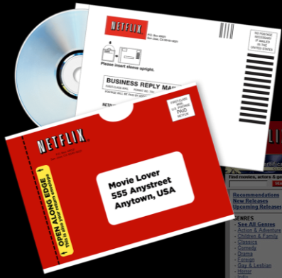

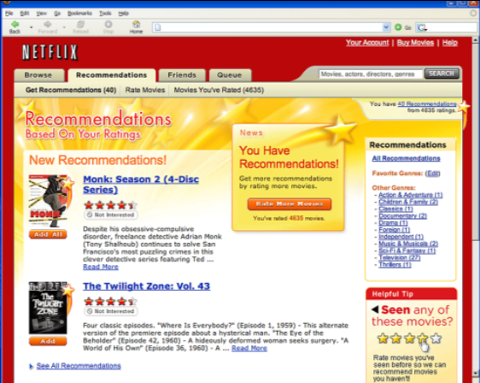
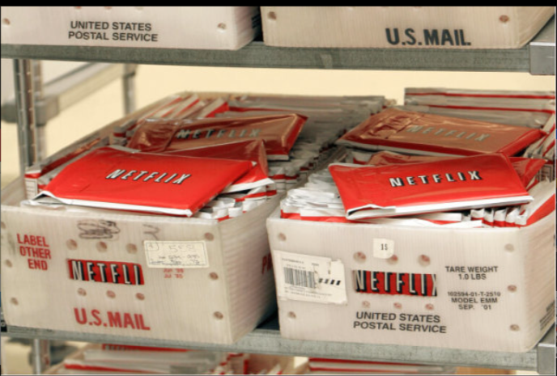
Product Road Map
Netflix.com, the first DVD rental and sales site, is launched. They later introduced a personalized movie recommendation system using members’ ratings on past titles choices.
The Profiles feature launches, allowing members to create different lists for different users and/or different moods. Membership grows to 5 million.
1998-2000
2005-2006
1997
2002-2003
Reed Hastings and Marc Randolph have an idea to rent DVDs by mail. They tested the concept by mailing themselves a DVD. The DVD arrived intact, and the idea for Netflix is born.
Netflix makes its initial public offering, at a selling price of $1 a share under the NASDAQ ticker NFLX. Later issued a patent by the U.S. Patent & Trademark Office to cover its subscription rental model.

Slide 6
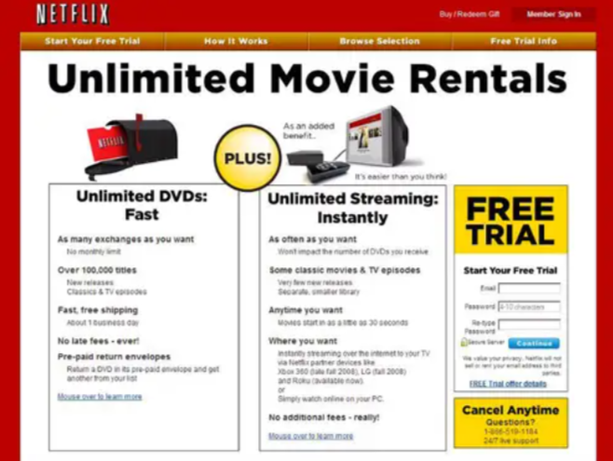
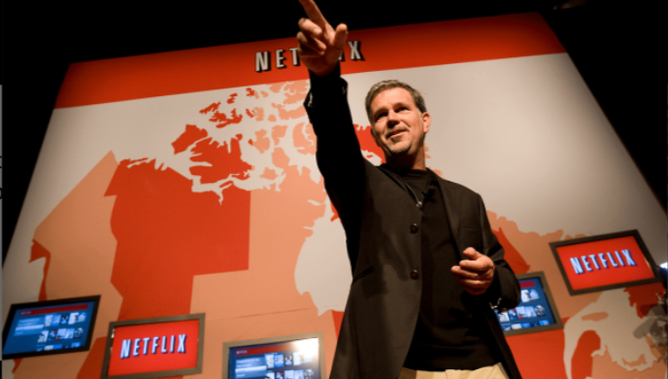
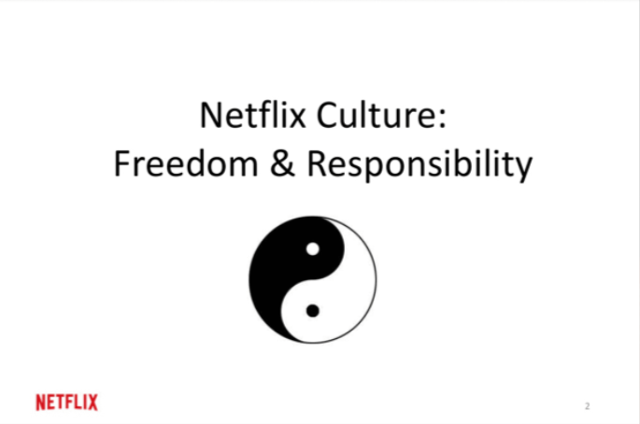

Product Road Map
After nearly three years and 40,000 submissions, the $1 million Netflix Prize is awarded to the team Bellkor's Pragmatic Chaos for improving the accuracy of recommendations by 10%.. The Netflix Culture Deck is published.
Netflix launches in Latin America, Caribbean, United Kingdom, Ireland and the Nordic Countries. The first Netflix button appears on remote controls.
2009
2011
2007
2010
Streaming is introduced, allowing members to instantly watch series and films. Partnered with consumer electronics brands to allow streaming on Xbox 360, Blu-ray players and TV set-top boxes.
In Canada, Netflix made its debut, marking the launch of streaming services on mobile devices. Additionally, the platform introduced its inaugural dedicated kids' experience, enhancing the streaming offering.

Slide 7
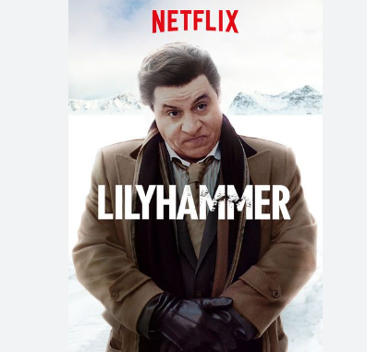


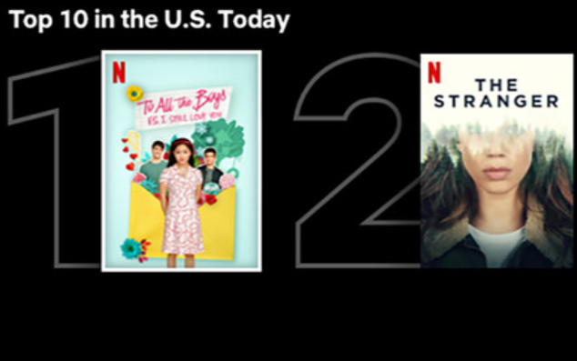
Product Road Map
'House of Cards,' 'Hemlock Grove,' 'Arrested Development,' and 'Orange Is the New Black' kickstart Netflix's original series. 'House of Cards’ received 3 Emmy awards. New features, Profiles and My List, debut on the platform.
Top 10 lists debut, allowing members to see what’s popular for the first time. Netflix is the most-nominated studio. Membership surpasses 200 million. Netflix launches mobile games. Today Netflix is in 190 countries and 64+ languages
2013
2020-current
2012
2016-2017
Lilyhammer, Netflix's first original TV series is premiered. Netflix ventures into stand-up specials with 'Bill Burr: You People Are All the Same.'
T mobile collaborated with Netflix creating a win-win scenario. Netflix expands to 130 new countries. The Download feature is added for offline and on-the-go viewing. Membership hits 100 million members globally.

Slide 8




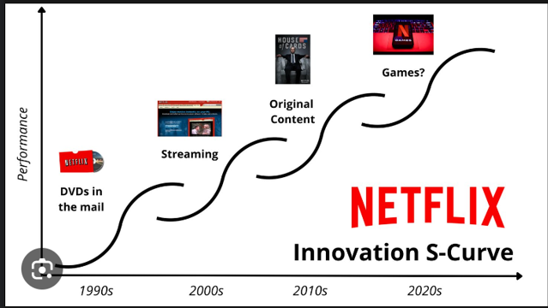
16+
CC
Innovation
2020
|
English
Season 1
DVD Via Mail
Netflix Application
50 min
54 min
Renting out DVD's through post
Multi-Device Compatibility
Website & Online Streaming
60 min
Developed its own website and started online content
Games
48 min
Interactive Games for users
User Friendly
50 min
Multiple language options with floating subtitles.

Slide 9

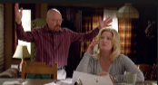


16+
CC
Disruptive Innovation
2020
|
English
Season 1
Streaming Model
Data-Driven Personalization
50 min
54 min
Smooth interface with user friendly nature
Recommend information based on personal preferences.
Dual Benefits
60 min
Netflix's Distinctive Edge and Content Rights Control
Impact on TV & Theatre
48 min
Challenging Traditional TV Networks and Studios
Interactive Content
50 min
Disrupts traditional linear storytelling, to a narrative engagement

Slide 10






Netflix
Home
TV Shows
Movies
New & Popular
My List
KIDS
Value Creation
Netflix
Global Exposure
Regional Content
Marketing
Technology innovations
Users
Sharing made simple
Subscription Plans
Optimized Viewing
Flexibility
Stakeholders
Partnerships
Acquisitions
Financial Performance

Slide 11



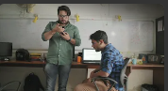


16+
CC
STICKINESS
2020
|
English
Season 1
UI & UX
50 min
Search Engine
54 min
Smooth interface with user friendly nature
Search results are accurate
Content
60 min
Recommendations
Worldwide collection – All language
48 min
user's viewing habits and the behaviour of similar users.
Freedom Unleashed
60 min
Unlimited access
Cancel Anytime
50 min
Ad-free, high-definition streaming anytime

Slide 12
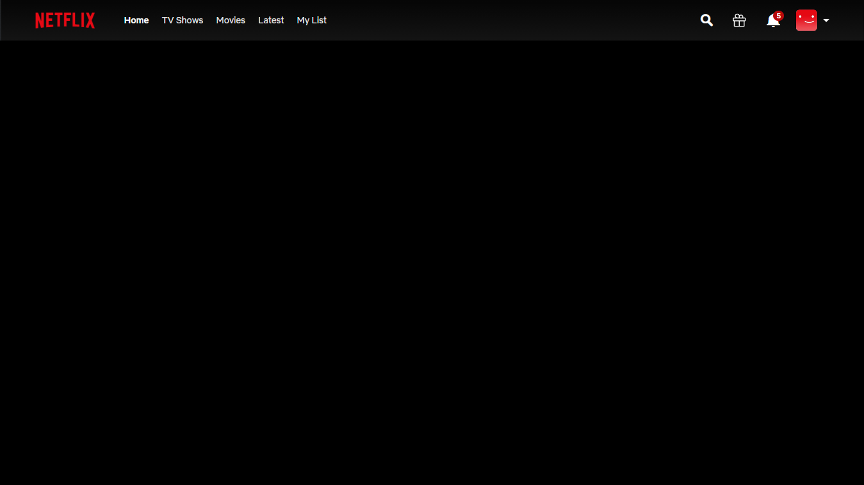
MARKET TYPES
New Market
Exponential Growth
Adjacent Growth
Captured early mover advantage by starting a streaming platform in 2007.
Availability & Affordability
Major advantages:
User Interactive, Diversified content, Personalized Recommendations
Live Sports starting with WWE
Exponential Growth from a DVD Rental company to $ 252.71 billion market cap
Annual Revenue:
2011 - $ 3.1 billion
2023 - $ 33.7 billion
As of Dec 2023, Netflix holds 260.28 million subscribers globally
Netflix Orginal Content :
-Premiered its first show in 2012.
Investing in making VR version of popular movies
Mobile gaming Services
Partnership with Regional streaming platforms.

Slide 13

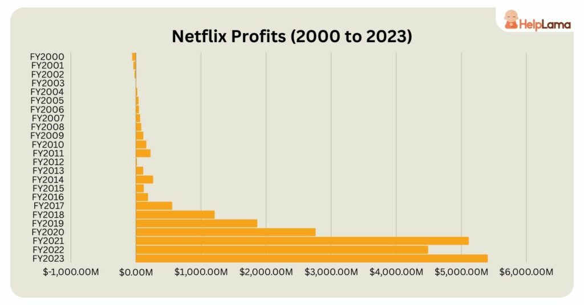
Financials
Consistent profit growth for Netflix from 2000 to 2023, indicating long-term business success.
Profit peak around 2018-2020, potentially due to successful content or strategic expansions. Highest Peak during pandemic
Flattening of profit growth in recent years, hinting at market saturation or heightened competition.

Slide 14
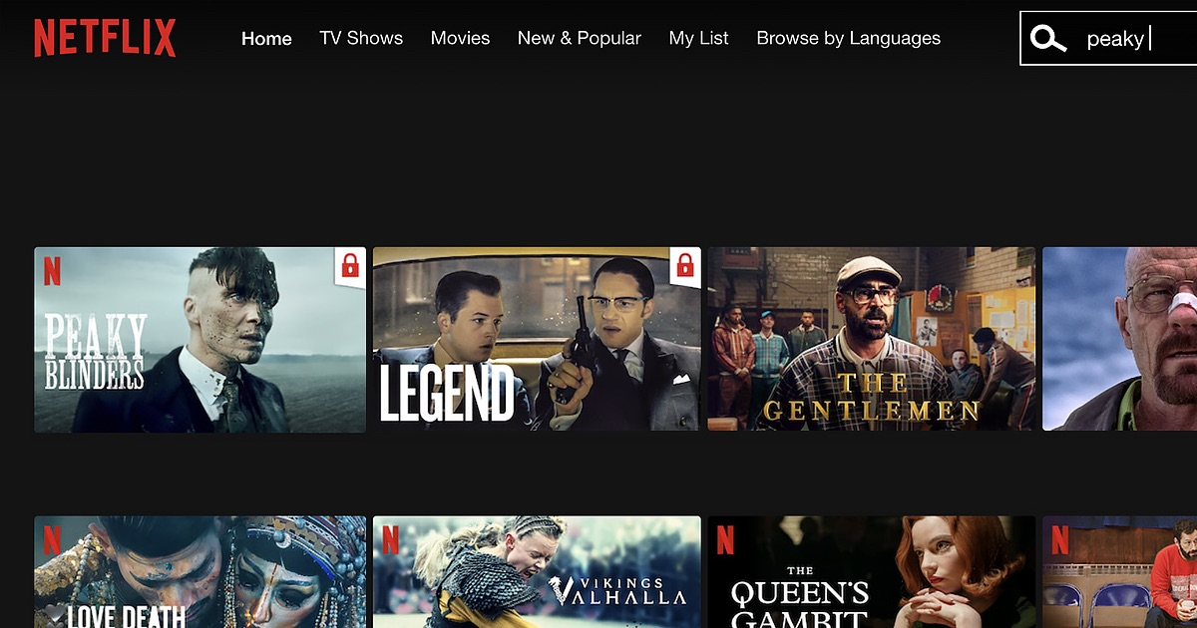


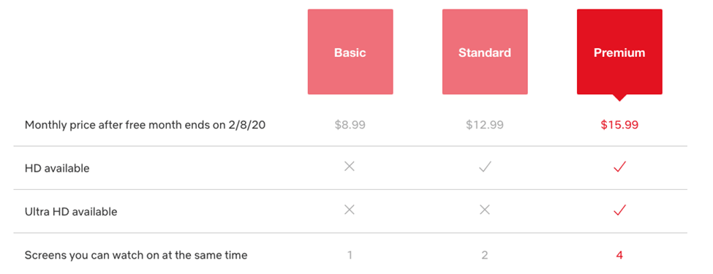
Market Strategy
PRODUCT STRATEGY
PARTNERSHIP STRATEGY
PRICING STRATEGY
PROMOTIONAL STRATEGY
Expanding the library
Accommodating different streaming qualities
Flexible payments Plans
Co-marketing with carriers
Bundling deals with service providers
Strategic carrier partnerships
Partnered with Electronic device companies and added Netflix button
Subscription-based model
Tiered plans
Free trial
No ads
Social media campaigns
Content teasers
Influencer partnerships
Netflix exclusive content
Limited-time offers

Slide 15
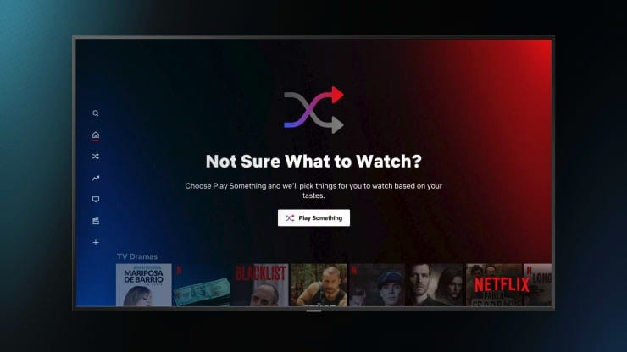
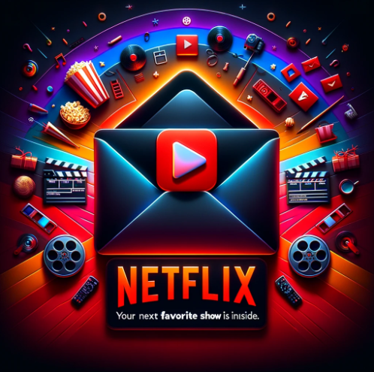
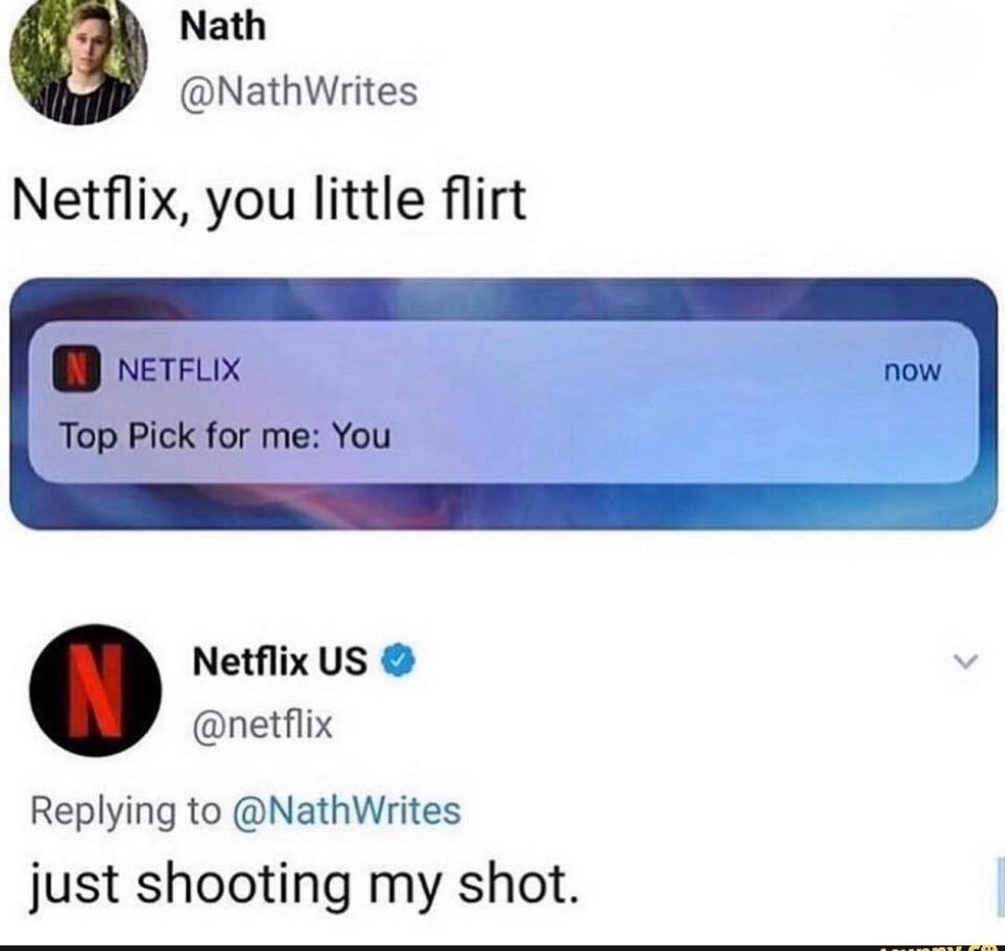
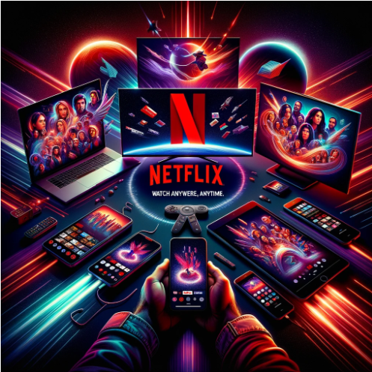
Netflix: Mastering Digital Marketing
Personalized Content
Targeted Email Marketing
Bird Box Effect
Multi-Device Accessibility

Slide 16

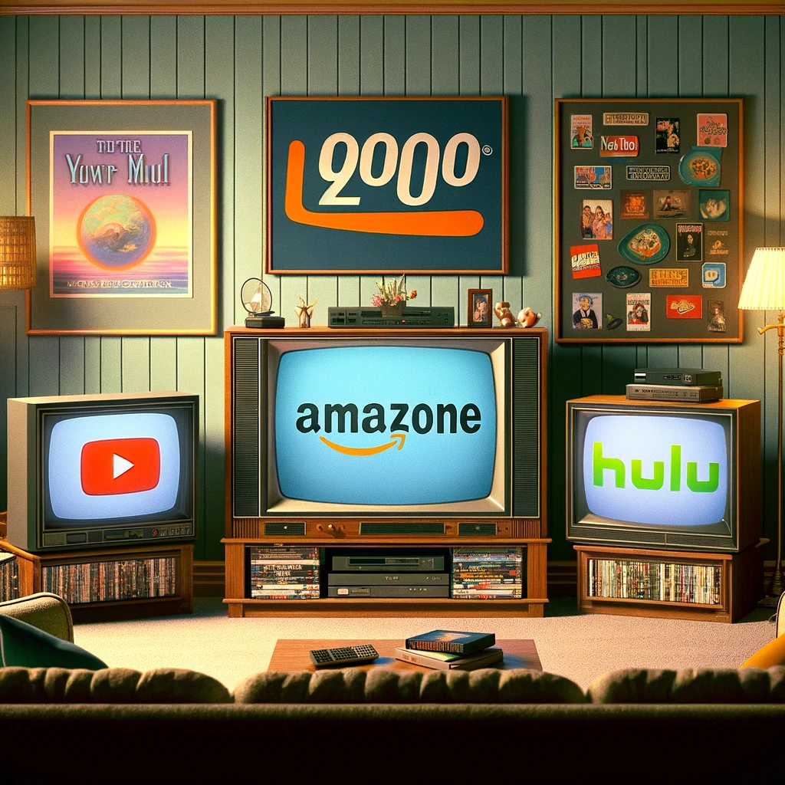
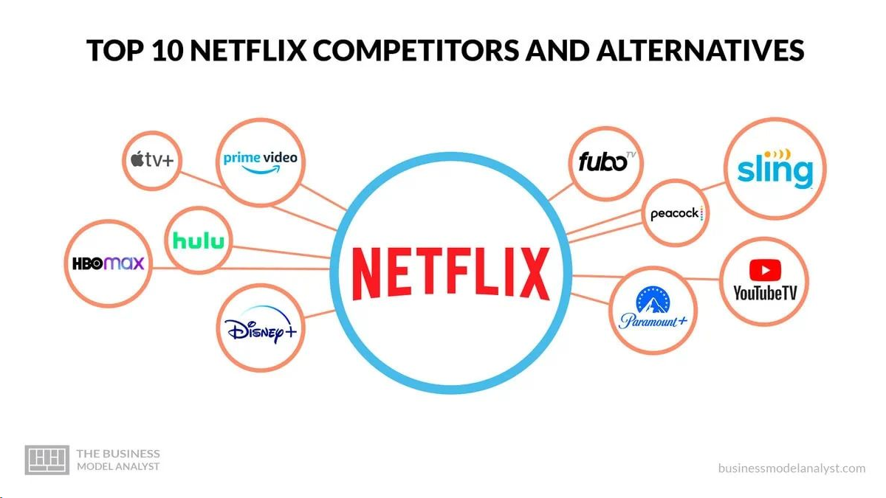


Competitors
DVD RENTAL ERA
Early Digital Entertainment
ORIGINAL CONTENT
CURRENT LANDSCAPE
HULU
Amazon Prime Video (Amazon Unbox – Amazon Instant Video)
YouTube
HBO Go/HBO Now
Disney+
Apple TV+
Peacock
Paramount+
YouTube Premium
Discovery+
HBO Max
Amazon Prime Video, Disney+, Apple TV+, HULU
International(BBC iPlayer, ITV HUB, Hotstar, Tencent Video, Rakuten TV)
Blockbuster
Hollywood Video

Slide 17


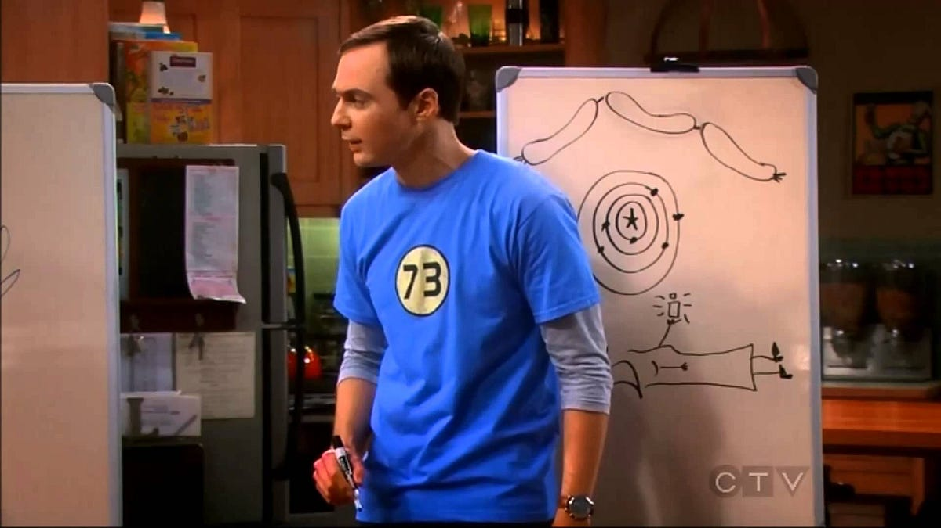
Netflix
Home
TV Shows
Movies
New & Popular
My List
KIDS
Critical Appreciation
Positives
Regional content
Global Reach
Content delivery innovations
Sustainability initiatives
Negatives
Content Rotation
Rising operation costs
Content quality variation
Peak Stagnation in market
Areas of improvement
Application for MAC
Netflix Music
Virtual Reality Cinematic Universe
Content portfolio diversification

Slide 18


Netflix
Home
TV Shows
Movies
New & Popular
My List
KIDS
THANK YOU
FOR LISTENING!
100% Done
18+
6 Members
Subject: Foundations of Digital Product Management
Professor:: Vasant Gondhalekar Group: 1
Tejanand
Subhash
Prudhvi Raj
Jyothsna
Rishitha
Sri Kiran
Questions? Clarifications FAQ About Us Help Center

Slide 19
References
The Brand Hopper. "The Evolution of Netflix: Power of Innovation in the Streaming Era." May 14, 2023. https://thebrandhopper.com/2023/05/14/the-evolution-of-netflix-power-of-innovation-in-the-streaming-era/#Growth_Strategy_of_Netflix
Forbes. "Streaming Stats." No date. https://www.forbes.com/home-improvement/internet/streaming-stats/
Cordcutting. "5 Biggest Lawsuits Against Netflix." https://cordcutting.com/services/netflix/5-biggest-lawsuits/
Product Habits. "How Netflix Became a $100 Billion Company in 20 Years." No date. https://producthabits.com/how-netflix-became-a-100-billion-company-in-20-years/#:~:text=Technically%2C%20Netflix%20wasn't%20the,the%20first%20streaming%20success%20story
Sprintzeal. "Netflix Marketing Strategy." No date. https://www.sprintzeal.com/blog/netflix-marketing-strategy#:~:text=Netflix's%20marketing%20strategy%20is%20data,channels%20are%20used%20for%20promotions
VdoCipher. "Netflix Revolution Part 1: History." June 2017. https://www.vdocipher.com/blog/2017/06/netflix-revolution-part-1-history/#1
Harvard Business Review. "How Netflix Expanded to 190 Countries in 7 Years." October 2018. https://hbr.org/2018/10/how-netflix-expanded-to-190-countries-in-7-years
Netflix about: https://about.netflix.com/en
https://www.netflix.com/tudum/articles/netflix-trivia-25th-anniversary#:~:text=Then%20nine%20years%20later%2C%20streaming,Netflix%20Original%2C%20premiered%20in%202012.

